Slide 1


CA2 Movie Review App (FWD)
Chan Jia Yi (P7337992)
9 August 2022
Github: https://github.com/cjy93/FWD_bootstrap_movie_review_app

Slide 2
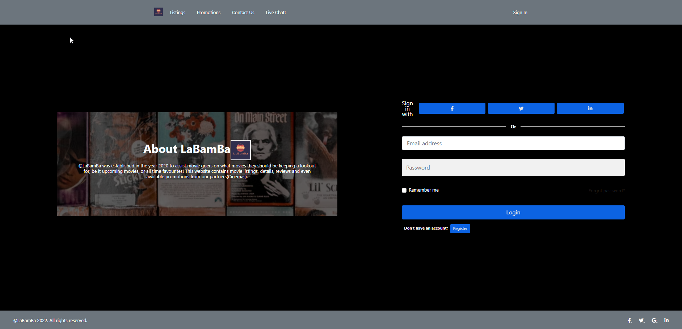

Index_login.html
1) Sign in with email(any) and password(any). If any is missing, will not pass the login stage
2) Click on “Register” and a bootstrap modal will pop up
3) All the navigator will point back to “index_login.html” if no local storage for variable email and password detected

Slide 3
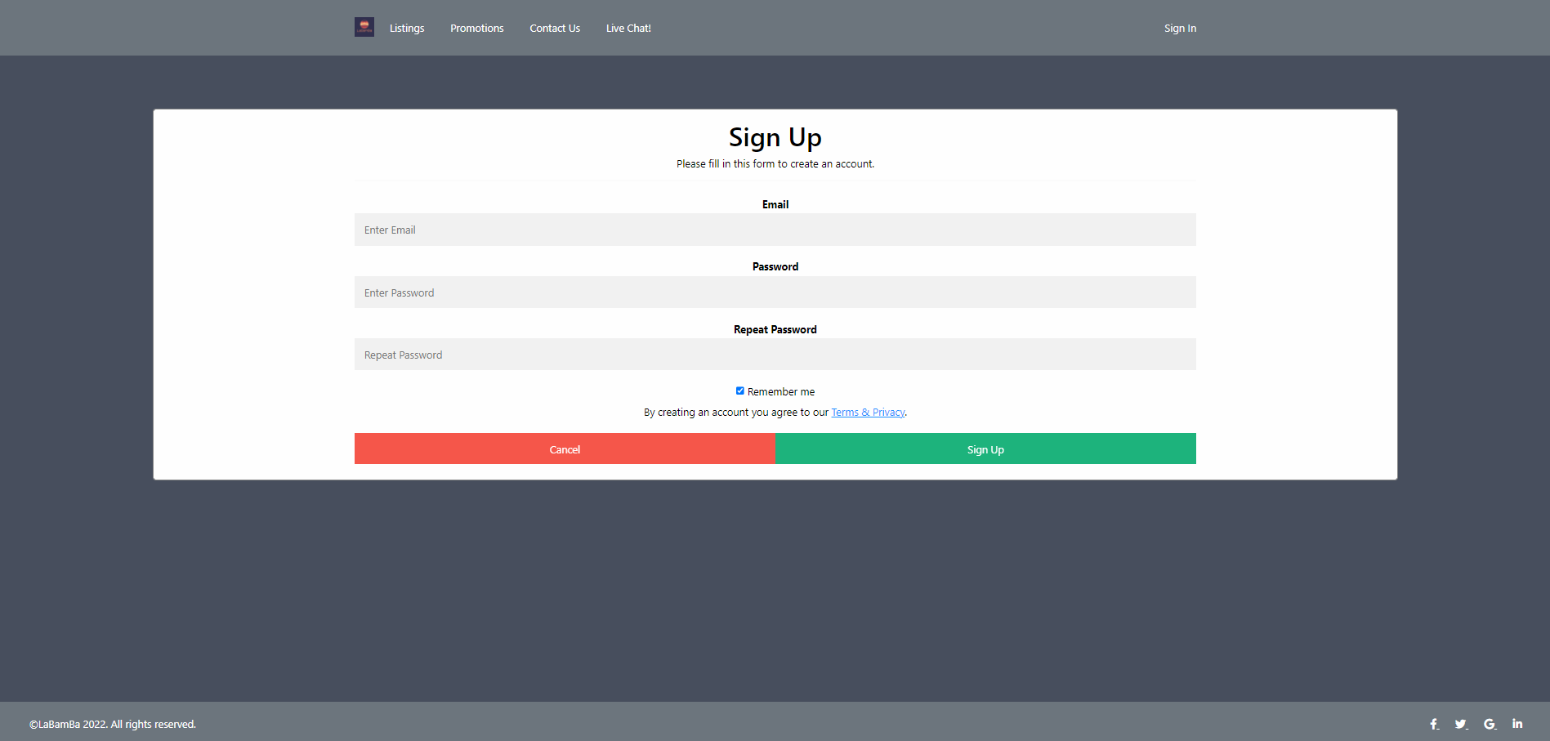
Index_login.html: click “Register”
1) On the Modal
2) You can click “cancel” to leave the modal or click “sign up”
3) Make sure all details are filled, or the signup will alert you to fill up the fields

Slide 4
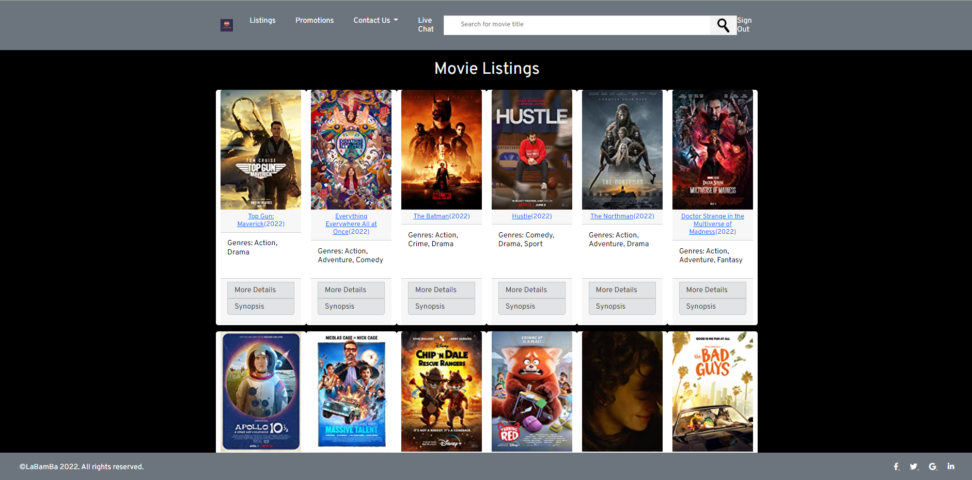
Listing.html
1) Upon login-in, landing page is at “listing.html”
2) At this point, all the navigation tabs will work since you are officially loggedin!
3) There are 43 Bootstrap Cards

Slide 5
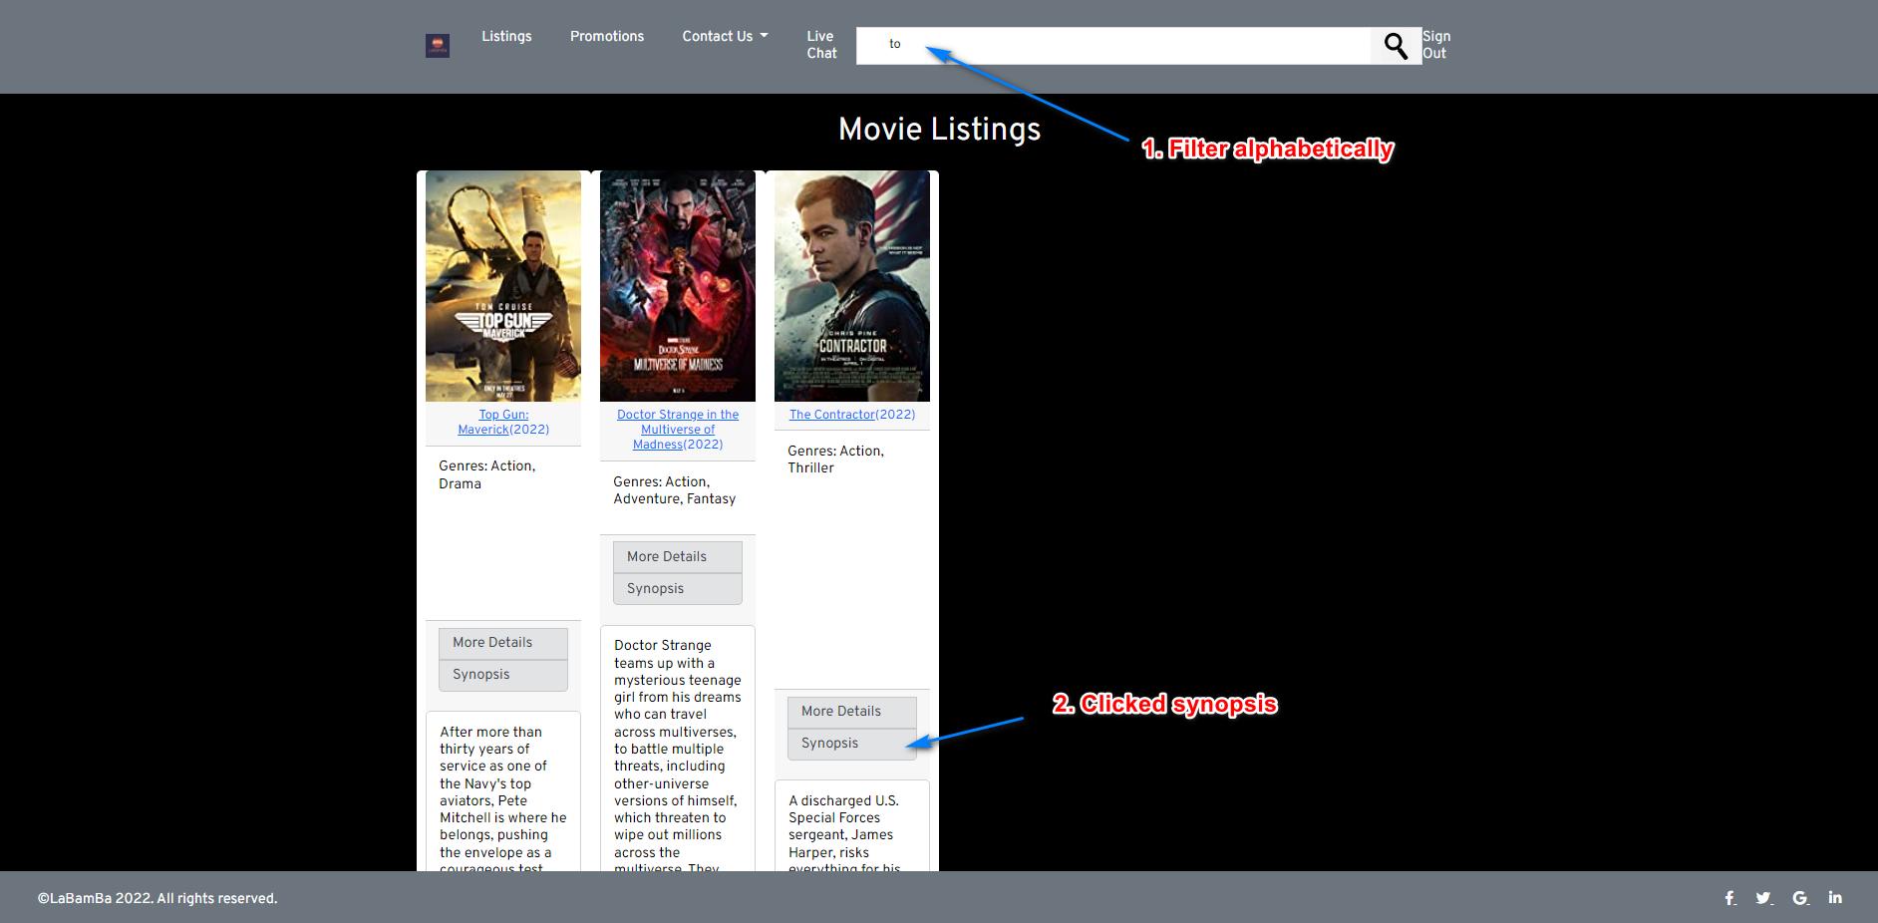
Listing.html: using search bar and clicking list group items
1) Filter movies with search bar
2) Click “Synopsis” to reveal bootstrap collapse
3) Click on “More Details” to go to “movieDetail.html”

Slide 6
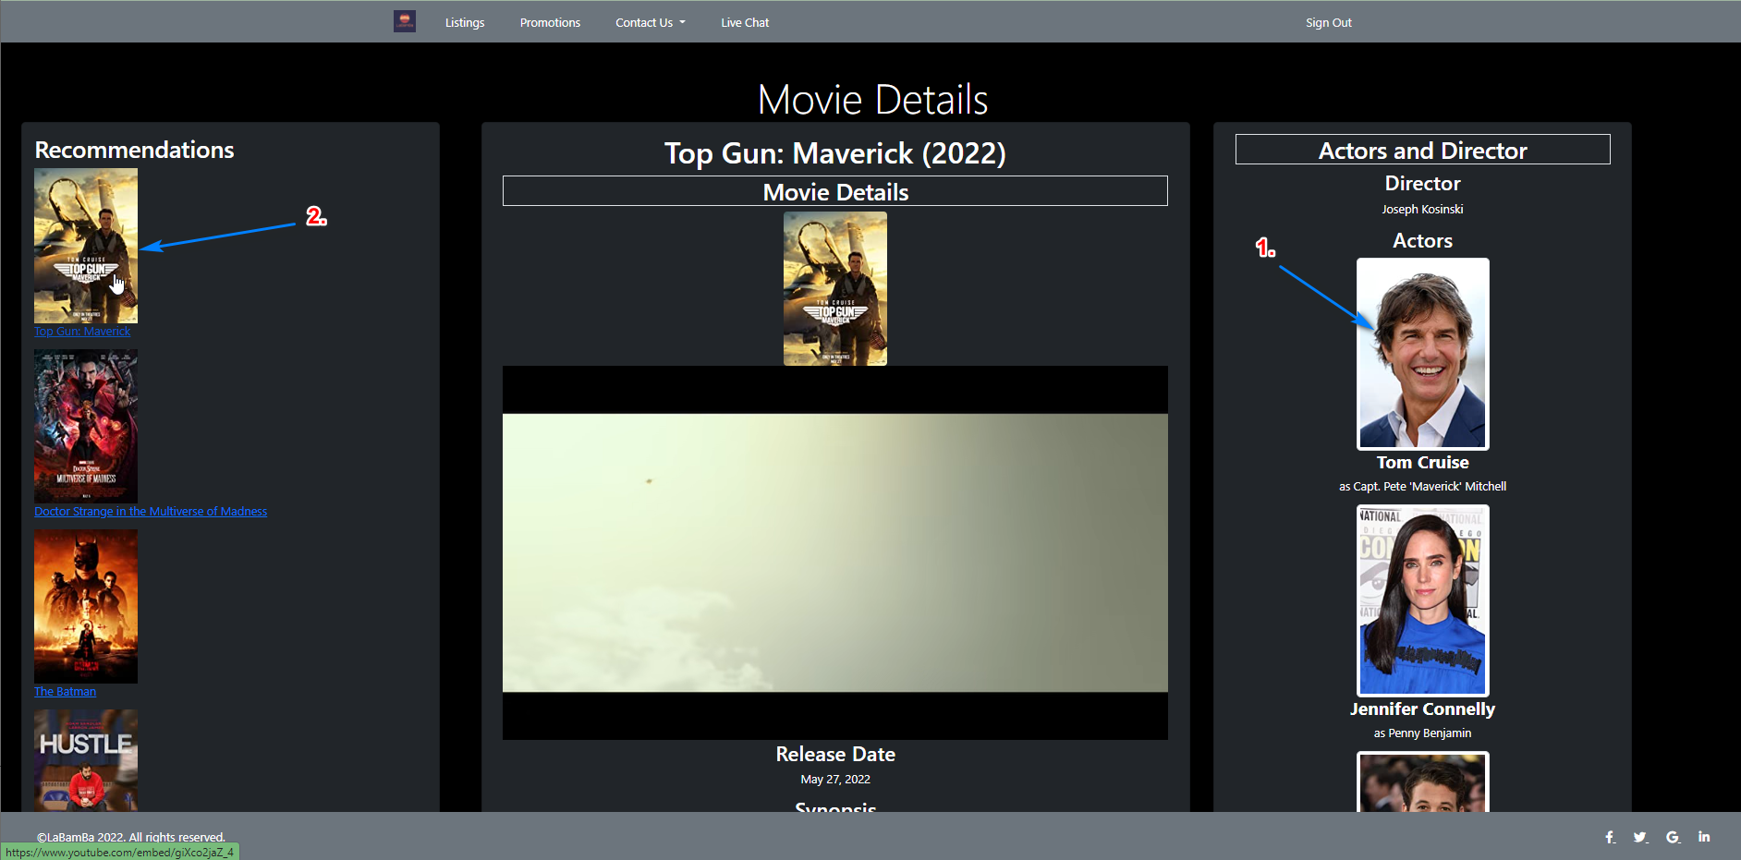
movieDetail.html (top third)
1) Click on actor image to lead to the official actor profile on IMDB.com
2) Click on the posters or movie titles in Recommendations to lead to trailer on Youtube.
3) There is a auto running Youtube video below the movie posters in the middle card

Slide 7
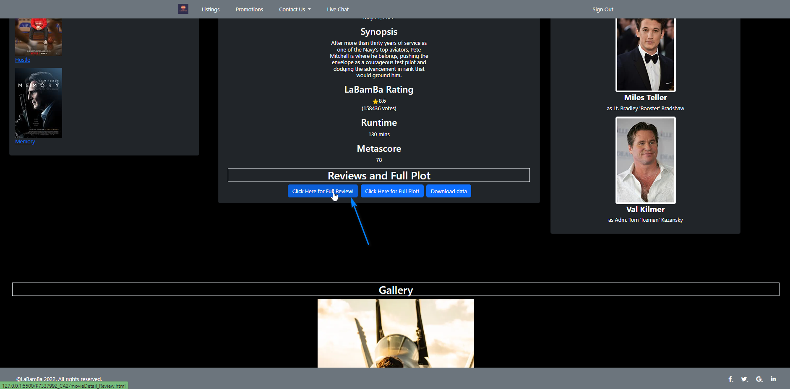
movieDetail.html (second third)
1) Click on “Click here for Full Review” to lead to any of the “[].html” files under folder “reviews_per_movie” where “[]” is the index number of the selected movie.

Slide 8
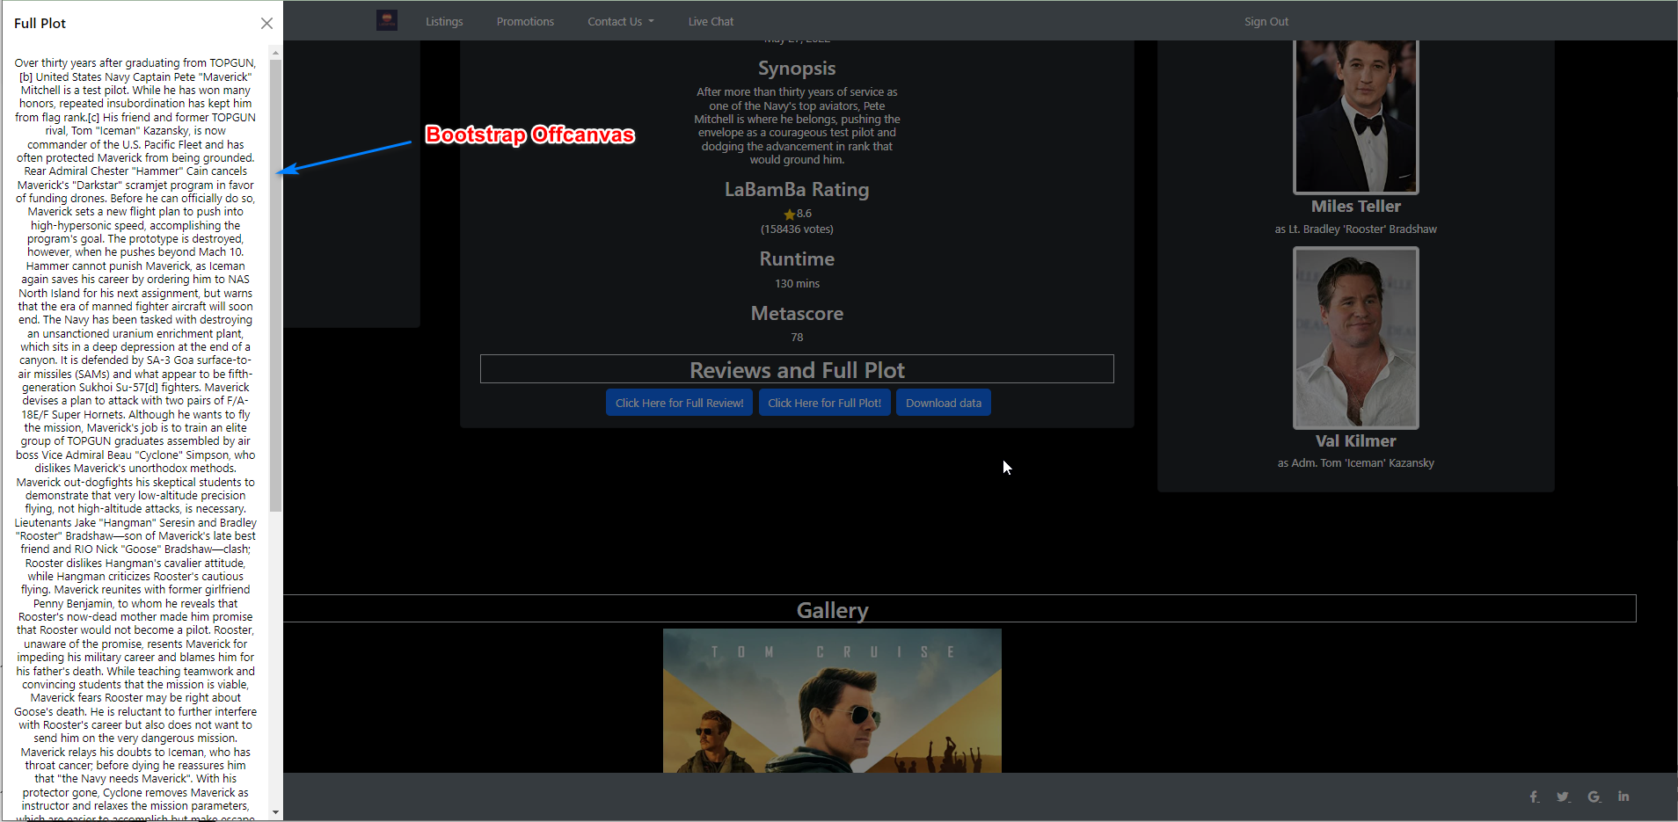
movieDetail.html (second third)
Click on “Click here for Full Plot” to reveal the Bootstrap Offcanvas feature
Lastly, click on “Download data” to download a backend csv dummy file I uploaded

Slide 9
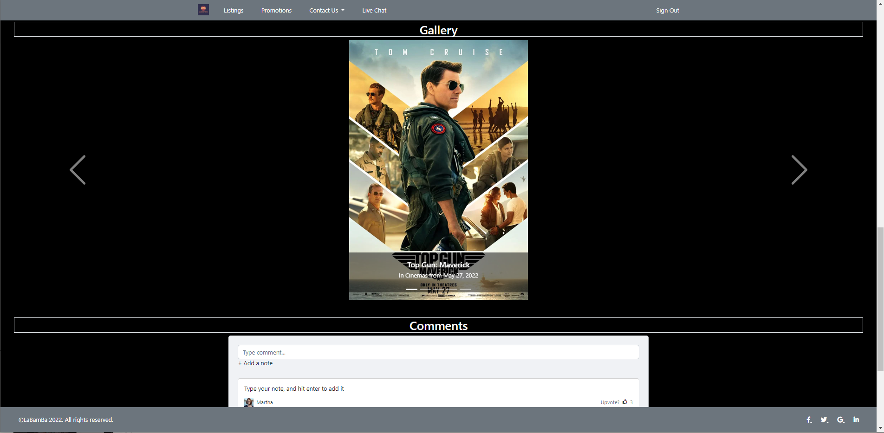
movieDetail.html (Last third)
The Gallery is a Bootstrap Carousel of 5 pictures full HD. I scrapped the images using Serapi Python.
There is a comments section, which is a static one (but it is not an image).

Slide 10
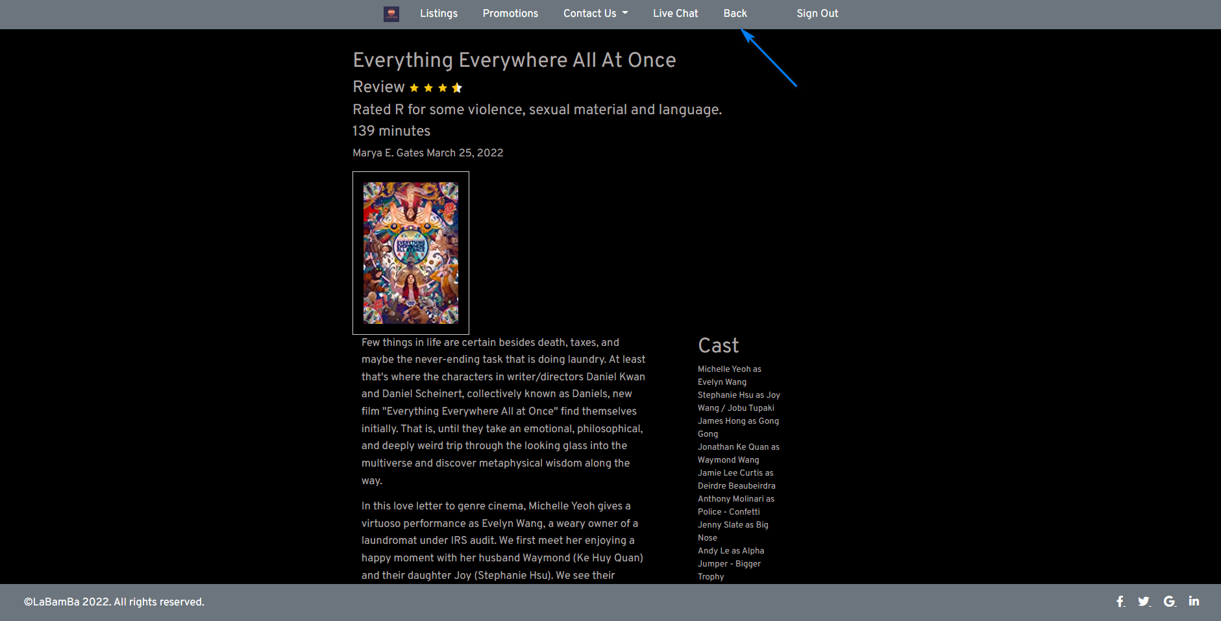
[].html (for [] from 0 to 42)
Review details page, but this is called from “movieDetail.html”, it is an embedded html code
Notice there is a “Back” option because there is no way to get back to “movieDetail.html” otherwise

Slide 11
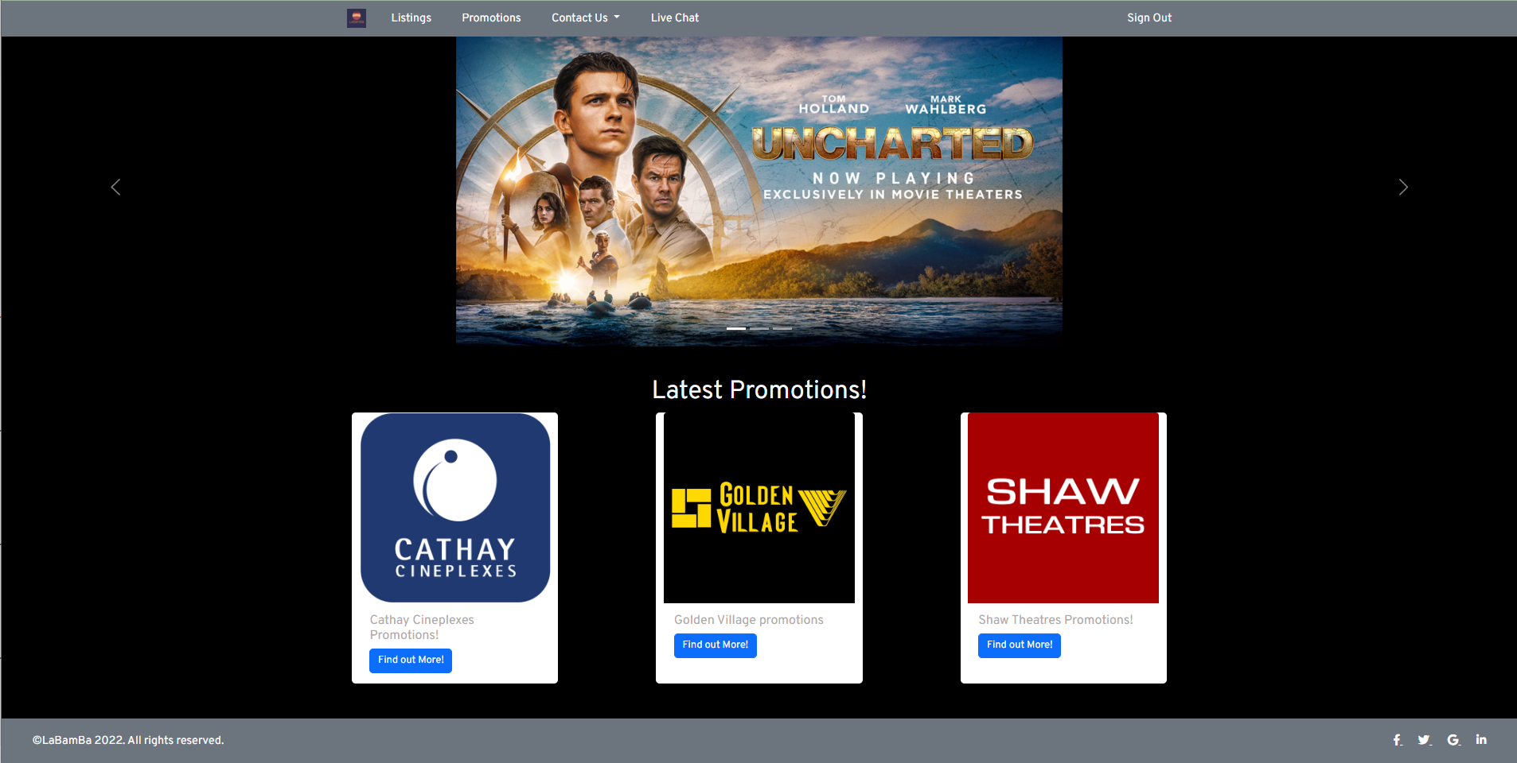
Promotion.html
Navigate to “Promotion.html” with the navigation bar.
At top is the Bootstrap Carousel followed with Bootstrap Cards
Click on the cards “Find Out More” to lead to “cathaypromotions.html”, “goldenVpromotions.html” and “shawpromotions.html”

Slide 12
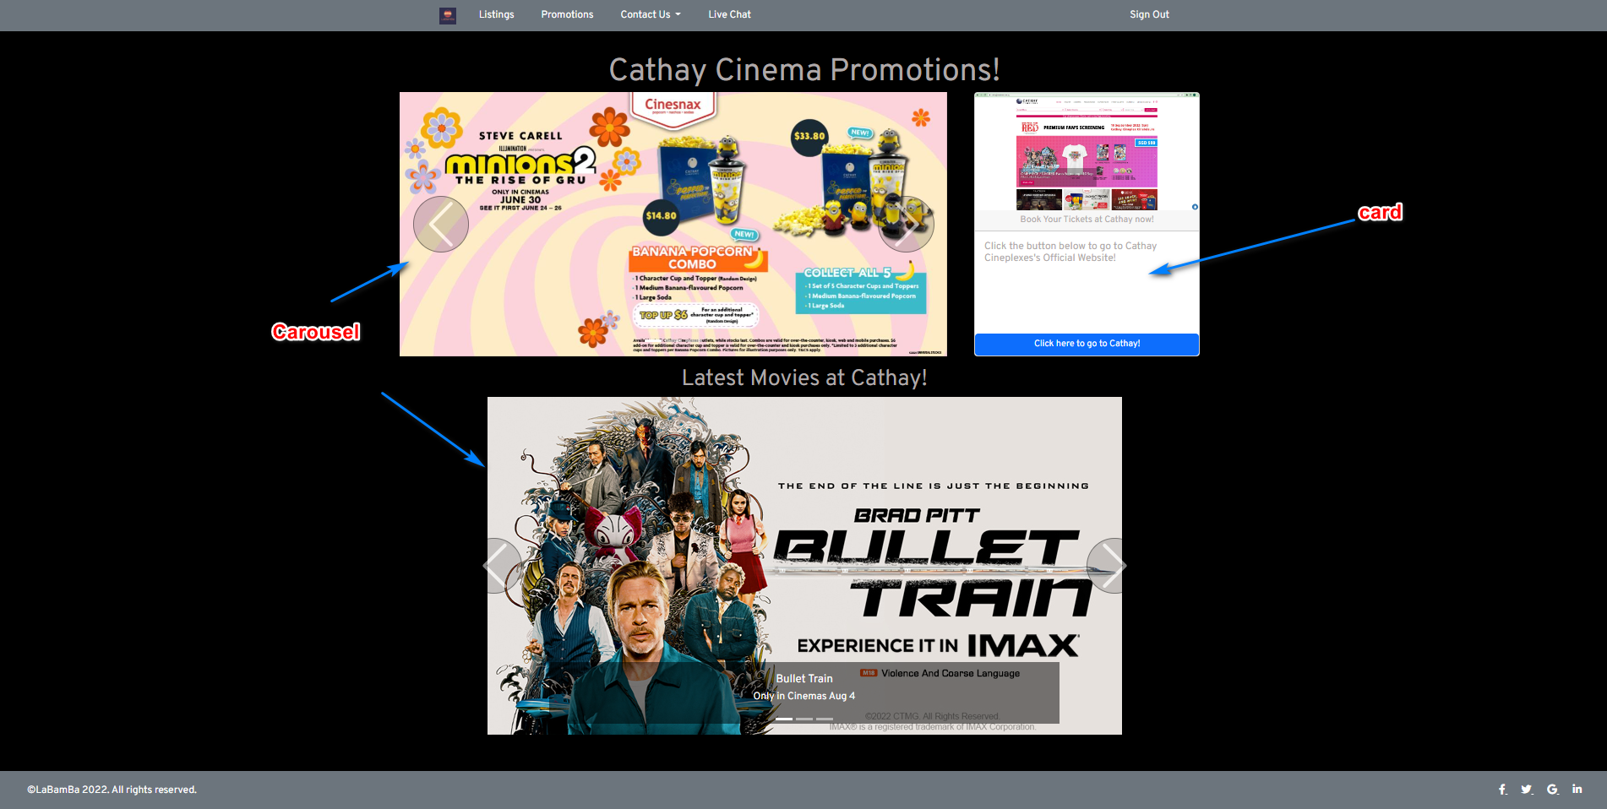
Cathaypromotions.html
There are 2 Bootstrap Carousels and one Bootstrap Card
Clicking on the cards will lead to the official “https://www.cathaycineplexes.com.sg/”

Slide 13
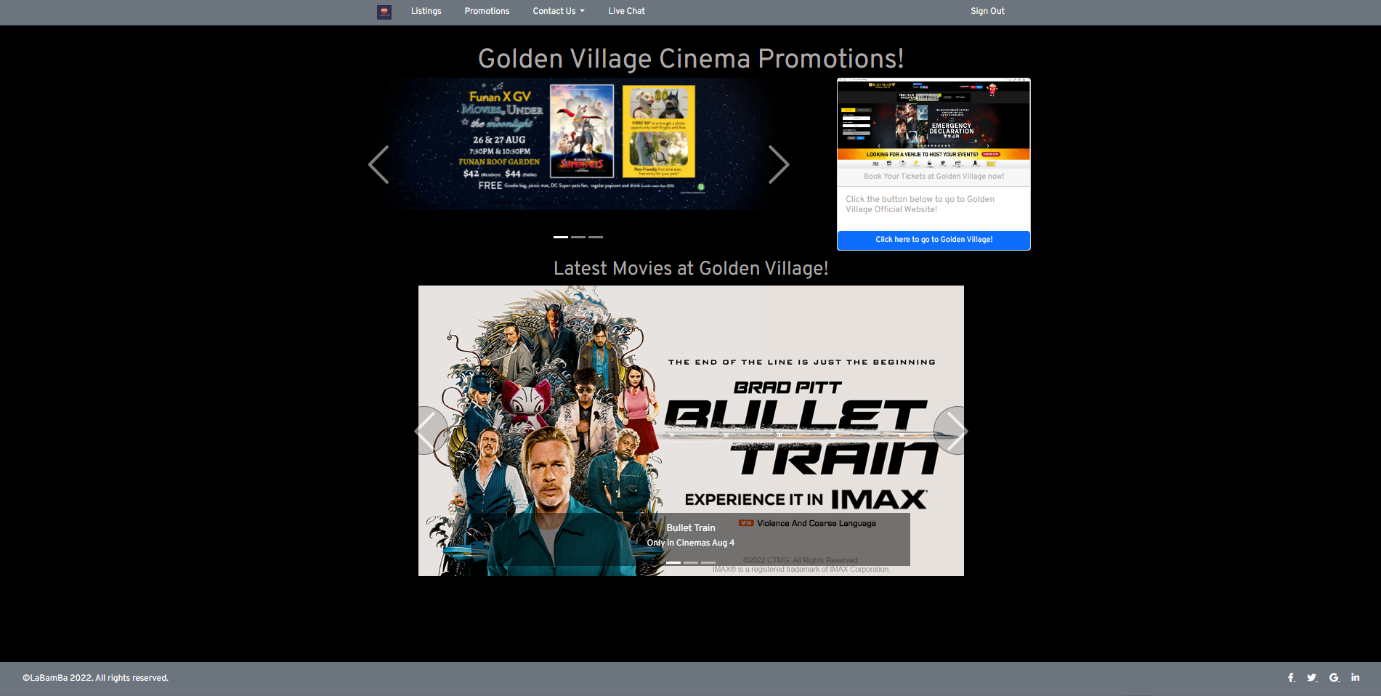
goldenVpromotion.html
There are 2 Bootstrap Carousels and one Bootstrap Card
Clicking on the cards will lead to the official “https://www.gv.com.sg/”

Slide 14
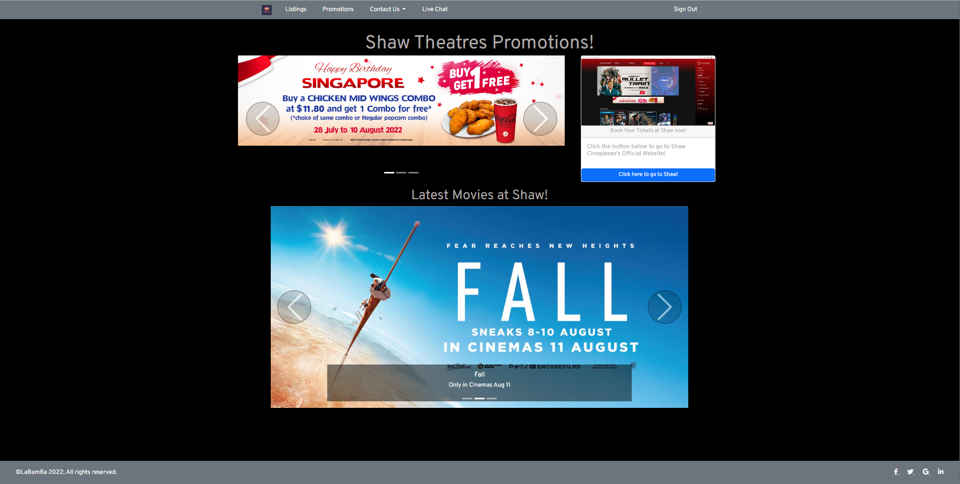
shawpromotion.html
There are 2 Bootstrap Carousels and one Bootstrap Card
Clicking on the cards will lead to the official “https://www.shaw.sg/”

Slide 15
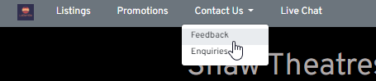
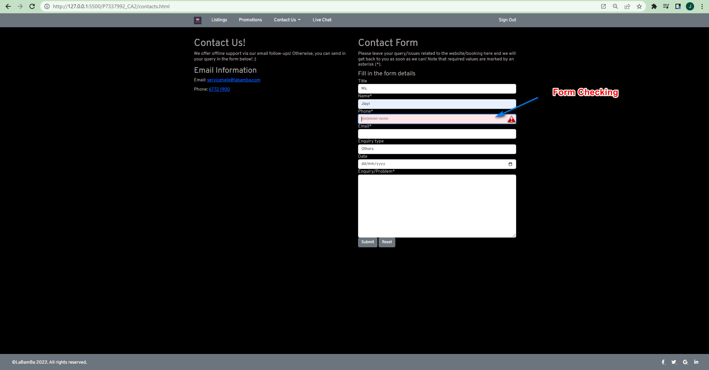
contact.html
Form using Bootstrap Form
Implemented form checking
Submit buttons and Reset buttons are working. Reset clears everything out. Submit sends the data to my google form, and returns if the POST request was working

Slide 16
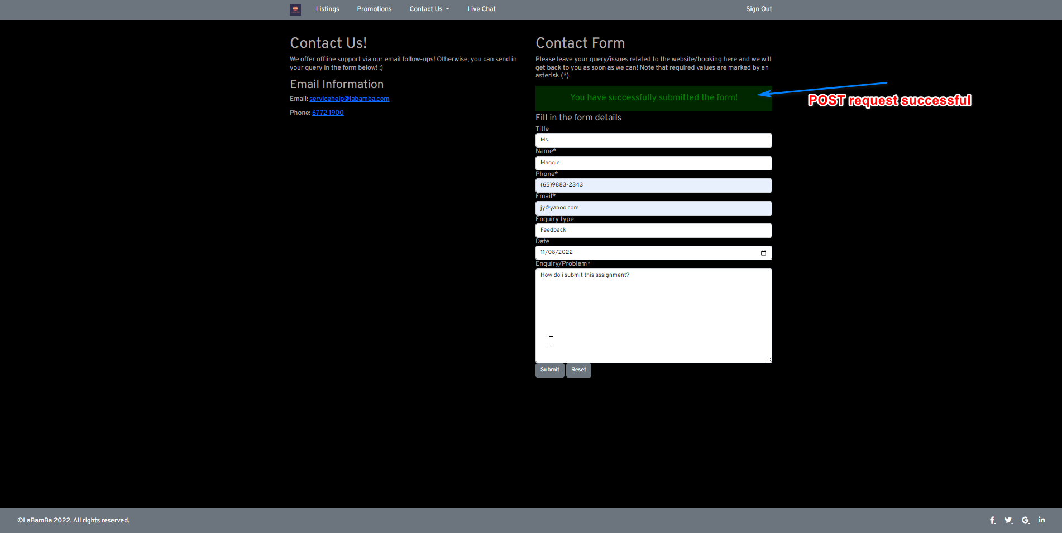
contact.html (working POST request)
If form submitted successfully, a success message in Green will appear on the page.
If not successful, an error message in Red will appear.

Slide 17
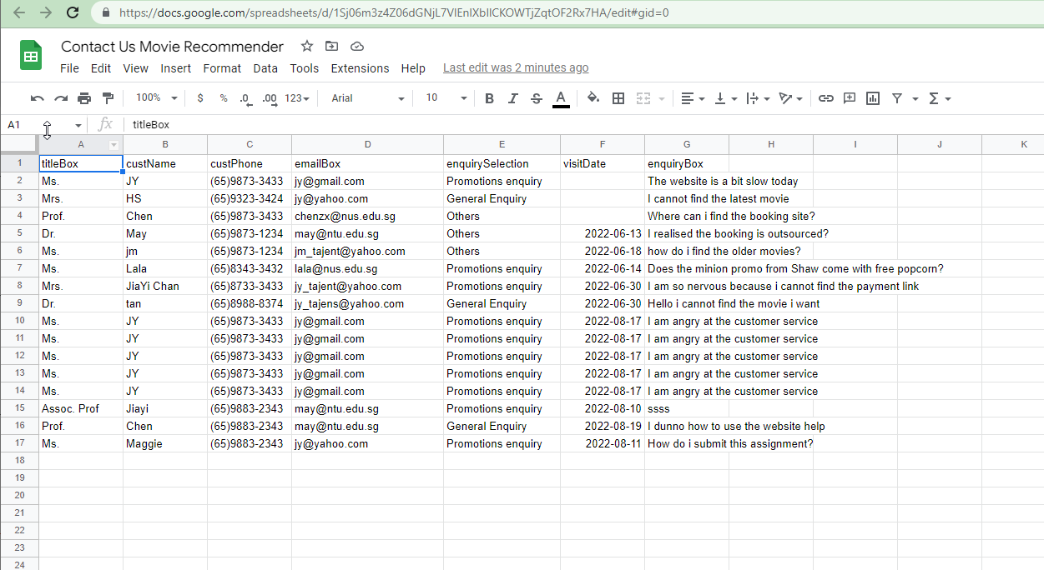
Google sheet (backend)
1) You can validate it at this link: https://docs.google.com/spreadsheets/d/1Sj06m3z4Z06dGNjL7VlEnlXbIlCKOWTjZqtOF2Rx7HA/edit?usp=sharing

Slide 18
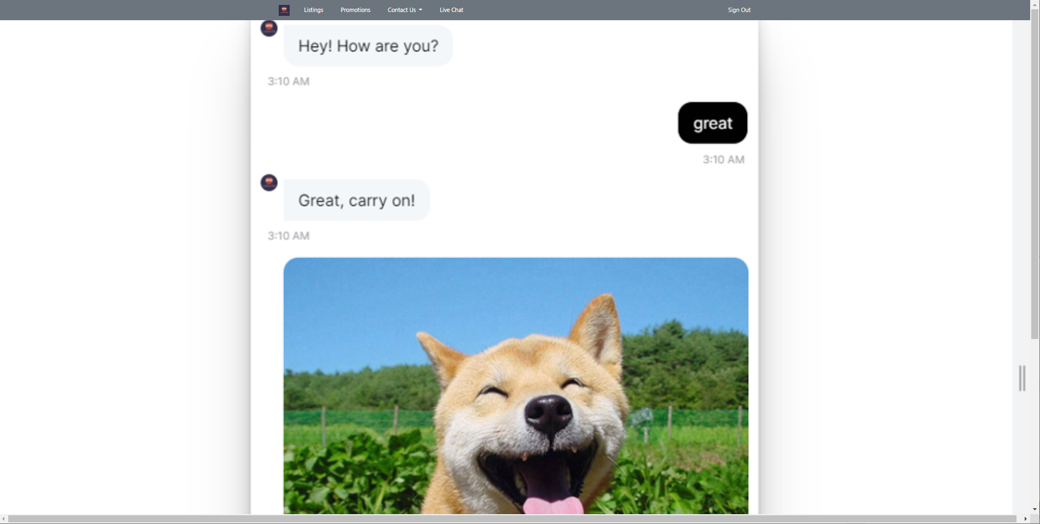
chatbot.html
1) Compared to Assignment1, I have replaced the RASA Chatbot with an image of it because the file is too large to submit in the submission folder. Nonetheless, checkout Assignment1 to find out how it is done!

Slide 19
Index_login.html
1) Sign in with email(any) and password(any). If any is missing, will not pass the login stage
2) Click on “Register” and a Modal will pop up
3) All the navigator will point back to “index_login.html” if no local storage for variable email and password detected

Slide 20
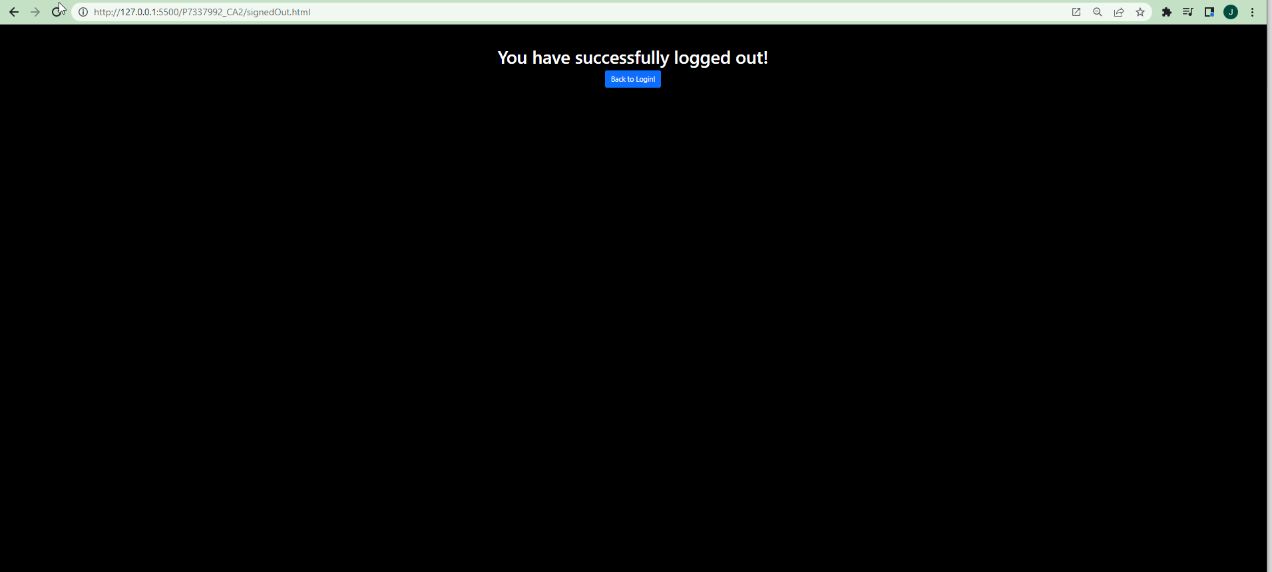
Sign out/Sign In function
Click the Sign out / Sign In function to delete the local storage of “email” and “password”. Click “Back To Login” to return to home page
After that try clicking on any of the nav tab and you will be lead back to login page! – You must login to enter the compound of the other features!

Slide 21
Further Work
Deploy webapp and Rasa server on Cloud providers
Use Hive and cloud databases to schedule the scrapping data process to database.

Slide 22
Thank you!

